Slide 1
A Hybrid Quantum-Classical CNN Architecture for Semantic Segmentation of Radar Sounder Data
Raktim Ghosh
Amer Delilbasic
Gabriele Cavallaro
Francesca Bovolo
E-mail: raghosh@fbk.eu

Slide 2
Outline
1
Introduction and Motivation
2
Problem Statement
3
Proposed Hybrid Quantum-Classical Architecture
4
Preliminary Results on Radar Sounder Data
5
Conclusions & Future Work

Slide 3
Introduction
Research activities have been carried out in the development of different types of Quantum Computers (QC), that incorporates principles of quantum computing to perform computations on qubits.
By utilizing the principles of QC, quantum algorithms address miscellaneous tasks such as quantum simulations, search and optimizations, quantum cryptography, etc.
In the domain of radar sounder, the data volume is large (e.g., SHARAD, MCoRDS) and will increase because of new operated instruments (e.g., RIME on JUICE).
Recently, Classical CNN and Transformers-based approaches have been developed to segment radar sounder data.
However, no attempt has been made to leverage the quantum related concepts in processing radar sounder data.
Notes:
Automatic vs visual inspection:
Objective vs subjective (misinterpretations)
Quantitaive vs qualitative (not reproducible)
Fast vs Time consuming
Cost of cluster vs cost of exter

Slide 4
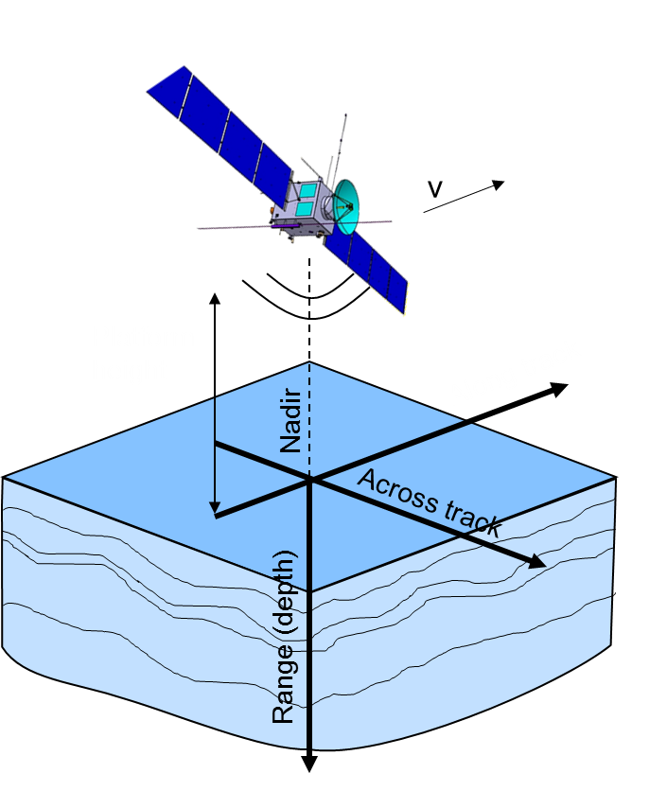
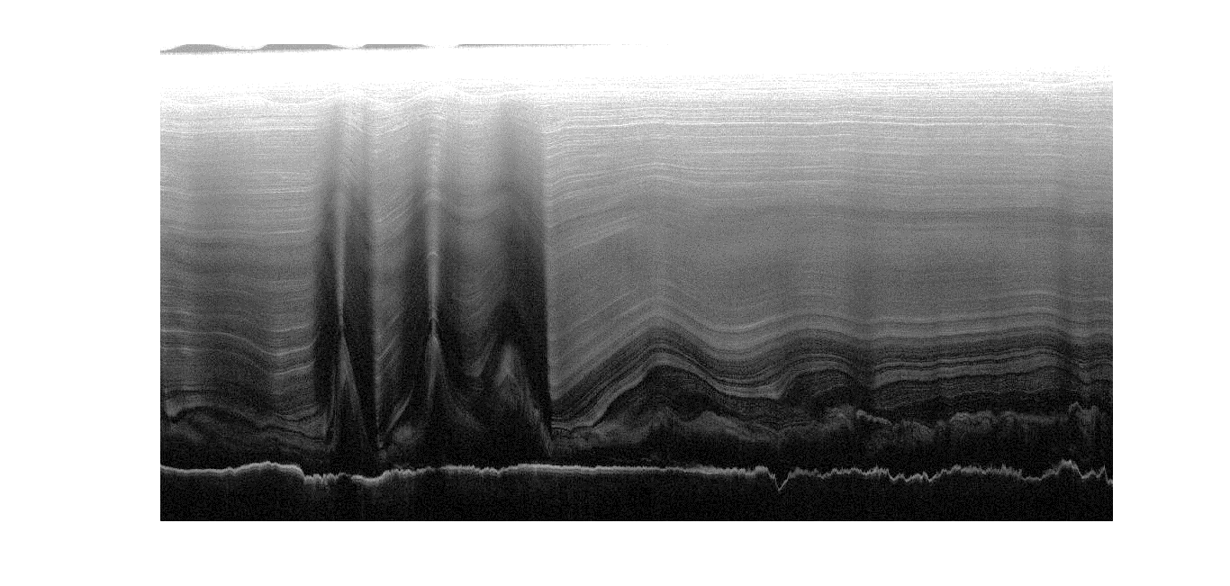
Radar Sounder
Radar Sounder technology
Transmitted EM pulses at low frequency (MF/HF/VHF) and with a wide band.
Wave penetrates the subsurface and at each dielectric discontinuity, a part of the EM wave is reflected back.
Radargram
A radargram is the coherent representation of backscattered echoes.
From a radargram it is possible to characterize subsurface target structures and estimate relevant parameters (i.e., dielectric properties, depth).
Azimuth
Radargram acquired in Greenland by MCoRDS
Internal Layers
Noise
Bedrock
Range

Slide 5

Problem Statement and Goal
Let us denote a radargram as:
Goal: to develop a hybrid supervised segmentation model using Hybrid Quantum-Classical (HQC) CNN architecture that assigns a distinct class to each pixel in R(i,j).

Slide 6
Hybrid Quantum-Classical Architecture
{(X_{n} L_{n}), n=1,..., N}
Input Training
Samples
Hybrid Quantum-Classical Encoder
Successive CNN Layer with Max pooling
Quantum Circuits - Bellman and Real Amplitudes Circuit
Quantum Embedding
HQC Bottleneck Quantum Layer
Successive Transpose Convolutions Operations to recover the Spatial Dimension
HQC Decoder
Loss Function

Slide 7
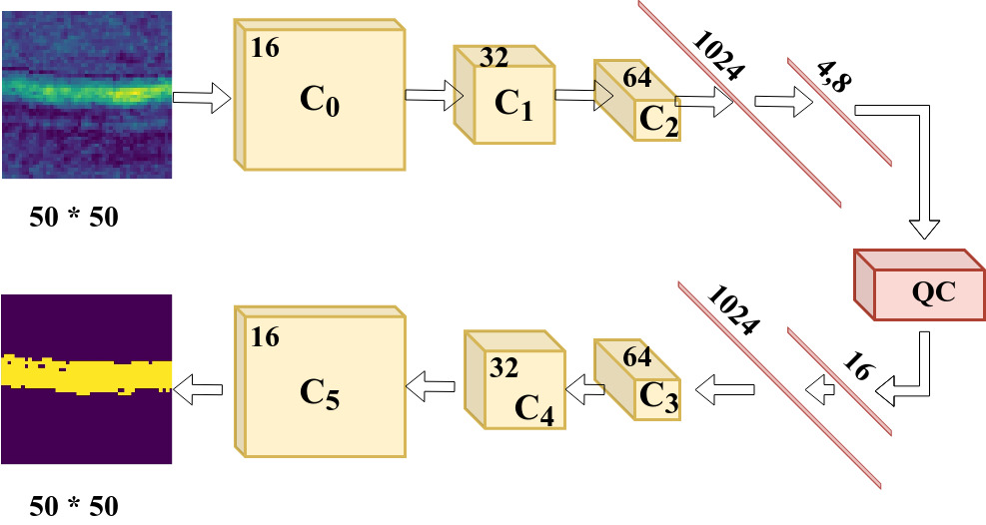
Hybrid Quantum-Classical Architecture
Convolutional Layers are used to encode the information to a latent space with reduced spatial dimension.
The information in the latent space is injected into the quantum circuits for estimating the probability amplitudes.
The probability amplitudes are utilized as an input to the Decoder to upsample the spatial dimension for the final predictions.
Schematic layout of HQC Architecture

Slide 8
Schematic Layout of the Hybrid Architecture
FC
FC
CNN
1024
4
C₂
C₁
64
QC Layer
32
C₀
16
C_{i} - i^{th} convolution operation
C₅
16
C₄
32
1024
C₃
64
TC
TC
TC
16
TC - Transpose Convolution

Slide 9
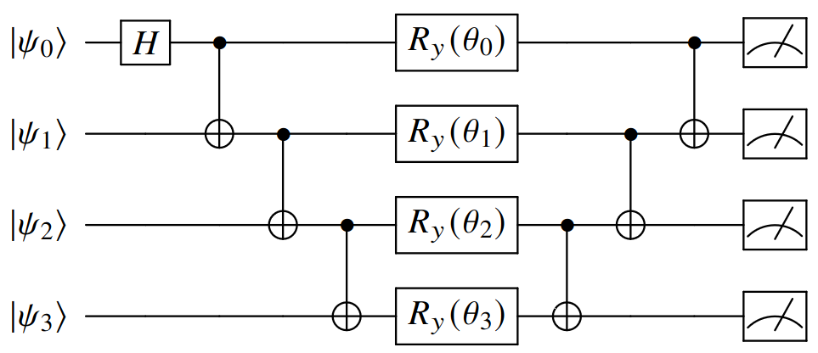
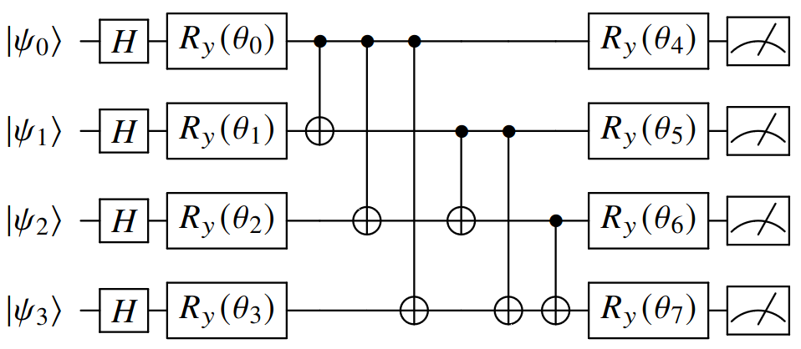
HQC Bottleneck Quantum Layer
The Circuit prepares an Entangled state by utilizing the Hadamard and CNOT Gates.
After the rotated entangled state, the CNOT processes are mirrored.
[1] - Bellman Quantum Circuit
The qubits are passed through corresponding Hadamard Gates with succeeding rotation gates.
The mutual entanglements are established with succeeding rotation gates.
[2] - Real Amplitude Quantum Circuit

Slide 10
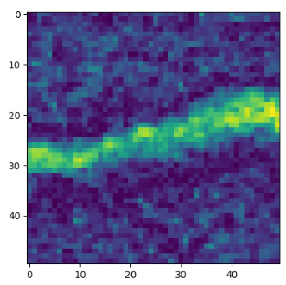
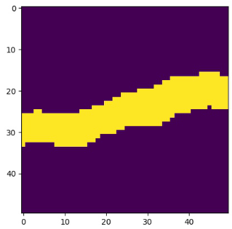
Experimental Setup
Sample radargrams acquired by MCoRDS3 Sensor (NASA)
Azimuth
Range
Parameters | Values
Number of Training Samples | 800
Number of Testing Samples | 254
Size of the Individual Samples | 50 * 50
Batch Size | 16
Number of Epochs | 50
Learning Rate | 0.00001
Optimizer | AdamW
Bedrock
Noise

Slide 11
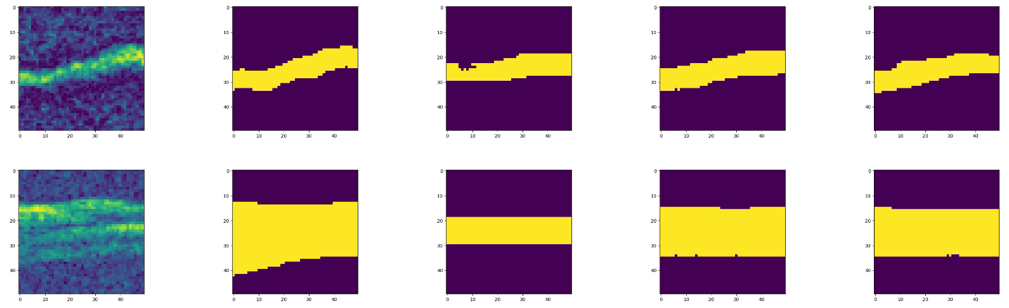
Qualitative Results
Azimuth
Proposed HQC approach
Range
Radargram
Reference
Classical
Bellman
Real Amplitudes
Bedrock
Noise
Qualitatively, the proposed HQC architecture accurately distinguishes the bedrock from the noise.
The classical counterpart was unable to distinguish bedrock from noise.

Slide 12
Quantitative Results
Algorithms | F1-Score | OA
HQC (Real Amplitudes Circuit) | 0.8477 | 93.93
HQC (Bellman Circuit) | 0.8248 | 93.13
Classical Architecture | 0.7407 | 89.55
The proposed architecture with the Real Amplitude Circuits achieved the highest rate of accuracy in terms of OA and F1-score.
F1-score improved 11% for Bellman Circuit and 14% for Real Amplitudes Circuit.
The quantum circuits as bottleneck connectors established a rich back-and-forth information processing system for the UNet-like architecture.
The contextual richness was decreased while using FC layer for the bottleneck connector as a counterpart of quantum circuits.

Slide 13
Conclusions & Future Work
Conclusions
We developed a Hybrid Quantum-Classical CNN architecture for radargram segmentation.
The architecture incorporates Quantum Circuits as a bottleneck between the Encoder and Decoder.
The method depicts a rich contextual discriminative information transfer between the Encoder and Decoder.
Future Work
Replace the classical skip connectors with quantum layers for the UNET-like architecture in miscellaneous parts of the overall HQC settings.
Explore the unsupervised settings with the Quantum Circuits.
Notes:
pubblicazioni

